Slide 1
How to Set Performance Test Requirements and Expectations
Presented by Ragan Shearing of Connected Testing at McKesson

Slide 2
Introduction
Experience – Consulting and FTE
Automation and Performance Lead
SQuAD Test Automation Panel – Twice
Today’s Focus – Setting Performance Requirements and Expectations
  Poorly understood
  Inconsistently implemented
Notes:
13 years of test experience, mostly with HP/Mercury tools with Automation and Performance Testing
Worked with internal and external customers. I’ve worked directly with on site customers
Worked as consultant and employee, in my experiences I’ve seen this as a consistent challenge across every Performance project I’ve worked on.
Performed Performance tests on a variety of web, SAP, and client server applications over the past ten years.
I want to present my experiences and thoughts on how I solve this problem for each project.
Ice breaker – for those of you who don’t know me, I have a six month old daughter. If your ring tone sounds like a crying child, I will try not to burp your phone.

Slide 3
Personal Experience – First Load Test Project
Mayo Clinic
  Four applications, all central to daily operations
  Problem – without requirements, how do we measure/identify failed performance?
  Lessons Learned:
    Any application can have some level of performance testing.
    Set performance expectations, have an opinion
Notes:
What led to this presentation? First and subsequent performance tests
Mayo Clinic, new hospital, loads of new software to run the hospital
Learned any application can be perf tested. PM/Business Group didn’t know what they wanted, had to lead them by the nose. Learned to have an opinion
Some of the poorest performance I’ve seen – can communicate poor perf, c/n communicate failure
Began to understand – End user Experience
Led me to the belief – c/n pass, c/n fail w/o requirements

Slide 4
Goal of the Presentation
Identify a process for setting performance requirements and performance expectations
Present examples of Performance testing experiences
Understand when Performance is Good Enough for the application at hand.
Share How I measure and Set Performance
  average just isn’t good enough
  the 90th percentile
Notes:
Growing Pains, share end lessons which make this a smoother process.
Aimed at testers, sometimes more test leads
Average doesn’t paint a complete enough picture

Slide 5
Present the problem – What is good performance?
Personal experience Cognos Reporting Tool vs. Amazon.com
“Will we know it when we see it?”
Is it good enough?
No single golden rule!
Performance is application specific
All about – End User Experience
Notes:
Cognos is a configurable reporting tool with a wide spread implementation.
In 98 or 99, the Gartner Group identified performance requirements of 1 – 5 = Good, 6 – 10 = Acceptable, 11 – 15 = Poor, > 15 = Unacceptable
For some applications, this might work. However, for most applications/businesses, it is just too expensive!!!
Overlaps but evaluate on own merits - Example – 2 gig doc download vs 2 meg

Slide 6
Broad Categories of Applications
Consumer Facing (Amazon.com)
  Need near instantaneous response – Work with an order placing or requesting tool, typically a core business application
Everything else – Work with a query or reporting tool, typically an application in a support role
  Internal usage
  Reporting Tools
Both categories have unique user performance NEEDS!
Notes:
Consumer facing – mostly web retailers
Ask Audience if web retail used.
Do companies own respond as fast?

Slide 7
Start - Performance Testing Questionnaire
Setting the requirements is an interactive process.
Start with understanding of customer’s expectation, expect to hear I don’t know.
Having a questionnaire is a great start, fill it out together with the customer.
Notes:
Begin with Questionnaire
Goal of questionnaire, begin the dialog to understand the application, usage, audience
Begins the dialogue, expect overlap in process
End goal, Performance test plan for PM/Group sign off.

Slide 8
Sample Questions for Performance Testing
Who is their customer/audience? Internal, consumer, business partner, etc
Main Application Functionality:
  Ordering, reporting, query, admin, etc
Application Technology:
  SAP, Web, Multi-Tiered Web, Non-GUI, Other__________
What is the current/future growth of the system?
Notes:
These are only sample questions. The questionnaire is the basis for starting.
Goal – to understand their expectation
Growth – ask to understand future implications and possible upgrade paths/knowledge
I have two examples of questionnaires I can email

Slide 9
Various Application Interfaces
Navigation
Doc download/upload
Saving/Changes
Information Download/Upload
Create ______ (such as order)
Large vs small downloads
Hurry up and wait screens/status screens
Notes:
Each of these may have unique performance needs.
These needs are based on company needs
Part of the discussion process, interactive

Slide 10
First Step – Set and understand the system usage
Understanding:
  Yours
  The Project’s
  Business Group
  Third party/vendor
20/80 rule
  Can’t test every piece of functionality or every permutation
Notes:
Need to make sure Project Team and Business Group are on same page
Most of the time, only 20% or so of an application makes up 80% of the application usage
Just a snapshot in time

Slide 11
Personal Experience - ITMS
Give example of ITMS and expected usage
  Vendor’s expected usage
  Company’s expected usage
  My expected usage
Application broke in production, information lost
Document Usage!!!
Notes:
Show of hands, who has or should have an annual performance review
Vendor – 1.5 hours
Company – didn’t know
Mine – 15 – 20 minutes
Part of Questionnaire

Slide 12
The questionnaire is filled out, now what???
Begin filling out test plan.
Not done talking with the customer.
Typical division of application functionality:
  Navigation: Tends to occur the most often.
  Data Submission/Return Results: Tends to occur half as often as navigation.
  Login/Logoff: Some systems may have multiple occurrences.
Notes:
Must review questionnaire
Review functionality
Ask what if _____ takes too long

Slide 13
After the Questionnaire cont…
Times should be driven by project needs
Discuss guidelines for functionality, my favorites are:
  Navigation responds within 5 – 8 seconds for the upper end
  Data Submission/Results Returned responds within 10 – 12 seconds on the upper end, 1 – 3 on fast end
  Login within 3 – 5 seconds
Notes:
No golden rule, only my guidelines
It’s important to discuss this because each application/project is going to have it’s own unique needs. If during the conversation, the customer has stated performance is of the essence, be sure to treat the times as such.
More important/consumer facing, identify faster times.
Help the PM understand the impact to their business and the users.
Give reporting example where 30 minutes response time was fine

Slide 14
Response Guidelines
Navigation: 3 – 5, 5 – 8
Doc download/upload: Size dependant
Saving/Changes: 4 – 6
Information Download/Upload: Size dependant
Create order: 1 – 3, 10 - 12
Hurry up and wait screens/status screens: Content dependant.
Notes:
What is a consumer/user willing to live with.
These are adjustable guidelines
2 gig doc vs 2 meg doc.
End goal – have PM make a conscience decision and get project sign off.

Slide 15
Second Step - Educate the Project Team
Present the guidelines relative to productivity
Introduce Performance Test Plan
  Let Team know you’re filling one out
Contents of a good Performance Test Plan:
  Identifies the performance requirements
  Lays out in black and white the testing to be done
  Identifies functionality not being tested
Notes:
Steps 2 & 3 go together and kind of overlap
Might do a partial walk through of the application and explain have performance of application would affect the end user experience at various points.
Apply the guidelines, help the PM understand impact to the user/customer
All along, filling out the Performance Test Plan

Slide 16
Third Step – Setting Performance Expectations
Ask them about business criticality of the application.
Set expectation for response times separate from capacity of users on the system
Notes:
If walk through of application hasn’t happened w/ discussion of guidelines, do so now.
Identify why the gui

Slide 17
Fourth Step - Review the Performance Test Plan to the Team/Group
Everything should be documented
Review Performance Test Plan with PM and Business Group
Contains pass/fail criteria and measurements
Buy in and sign off:
  Business Group/Owner
  Project Manager
Notes:
Performance test lead has been filling this out all along!
By this time, the Performance test plan should be completed.
End goal, their sign
Review with PM and stakeholders!!!

Slide 18
Run the Test!!

Slide 19
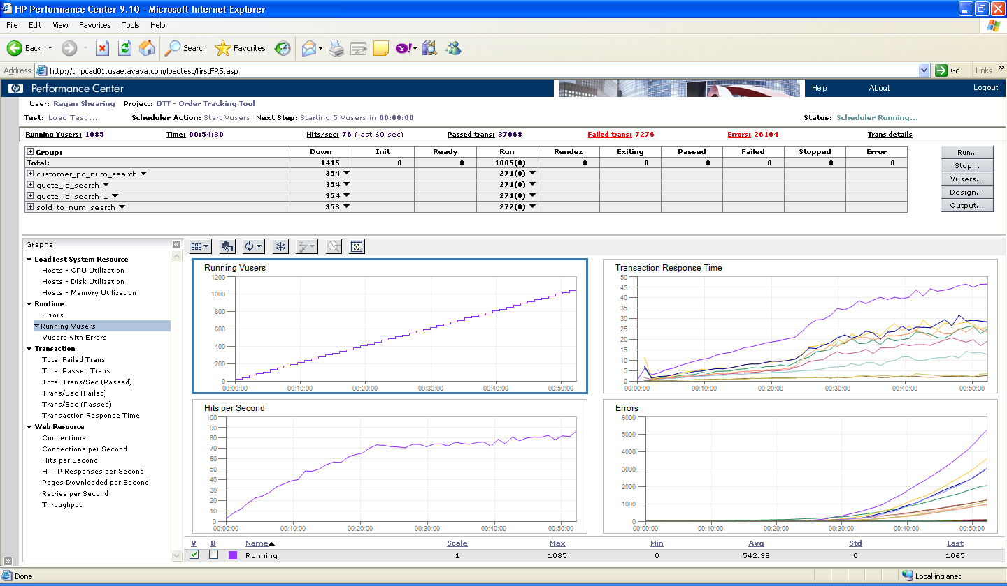
Fifth Step – Run the test
Notes:
Snapshot of Performance Center
By this point, magic has happened, scripts created, debugged, parameterized, etc
Talk about what it is doing

Slide 20
Performance testing is an iterative process.
Test early, test often
Don’t wait until the end of a project, you may run out of time
Cannot “Test in better performance”
Better performance comes from a group effort of db/system admins, developers, and managers
Better performance costs $$$
Notes:
Typically Perf testing at end, when problems arise, it will be too late!!

Slide 21

Personal Experience – Iterative/Tuning/Don’t Wait
MSQT
Government Project
Lesson Learned – Don’t wait to the end!!!
Notes:
MSQT – originally poor performance. Had to re-code about a third of the application
Government project – got on site, not much ready but started with login. Failed at 2 users! Took two weeks to troubleshoot poor db configuration

Slide 22
Sixth Step – the Test has Run, now what?
Compare the results to the expectations/requirements
How close is close enough?
When to change or update expectations based on performance
Present the results as they relate to user/customer productivity
  Faster response times = greater productivity
  Point of diminished returns
Notes:
Close enough – get PM to sign off on close enough or not.

Slide 23

Poor performance, what to do
Tuning Runs as time/budget allows
Add status bars/screens
Communicate to future users
Future test efforts

Slide 24

Good Performance, what to do
Save a baseline
SHIP IT!!!
Notes:
Ship it, if it’s the last build…

Slide 25
Summary of Steps
Introduce Questionnaire
Understand system, and usage
Educate the project team
Set and document expectations, part of the test plan
Get sign off
Run the test
Possibly re-run the test
Last – Review Test Results with Team
Notes:
Remember all about end user experience

Slide 26
Wrap Up
Base the Goals, Expectations, Requirements of the performance testing on the needs of the business and end user.
Educate the project team on importance of good performance and cost of poor performance
Keep results as baseline to identify how changes affect the future system
Notes:
This requires an active dialog.

Slide 27

Questions
Contact me via email:
  iradari@yahoo.com
Will send a copy of performance testing questionnaires for creating a performance test plan.

